Slide 1
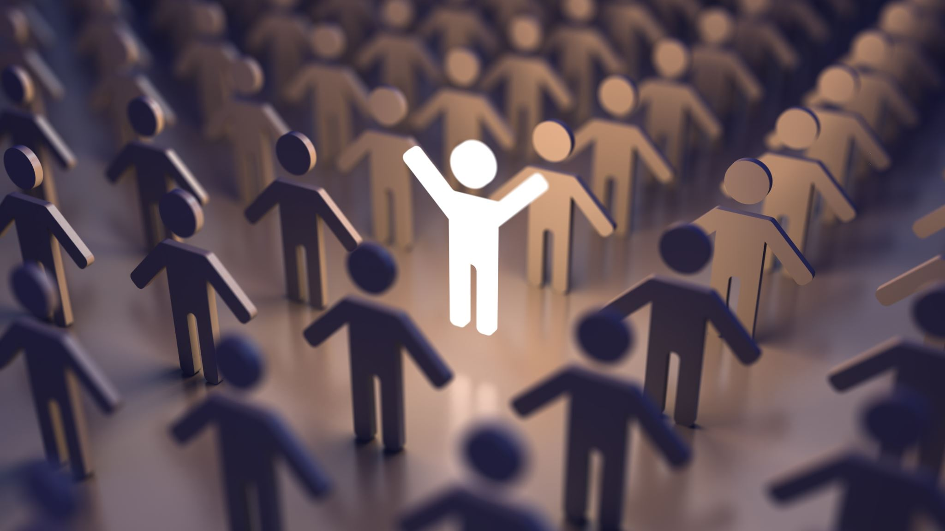
I disagree!
Student Health and Human Services
Office of Human Relations, Diversity & Equity
June 2022
Notes:
Please feel free to encourage student participation whichever way you are most comfortable: in the Zoom chat, on a previously shared Jamboard, in break out groups, or all together in a grid view. There will be a lot of opportunities for participation throughout this presentation.

Slide 2
Welcome!
If you could have one meal with any famous person (dead or alive), who would it be?
Notes:
Invite the students to share the response to the question using whichever platform you prefer.

Slide 3
Objectives
Observe various ways people engage in disagreements
Learn 5 Steps to Respectful Disagreements
improve communication skills regarding disagreements
Notes:
Read the objectives to the students.

Slide 4
Pay close attention to these arguments...
Notes:
Let the students know we are going to watch a few videos about disagreements. Encourage them to pay attention how these characters engage in disagreements.

Slide 5
Notes:
Play the video for the students. (1:18)
grown-ish Season 2, Episode 8 | Jazz & Sky Argue | Freeform - YouTube

Slide 6
Notes:
Play the video for the students 1:50
Schitt's Creek - "You Get Murdered First!" - YouTube

Slide 7
Reflection
What stood out to you about these arguments?
Were there any parts that seemed productive?
What parts were the most unproductive?
Notes:
Engage in reflection with the students. Encourage them to reflect and those who are comfortable to respond to these questions in whichever format they prefer.

Slide 8
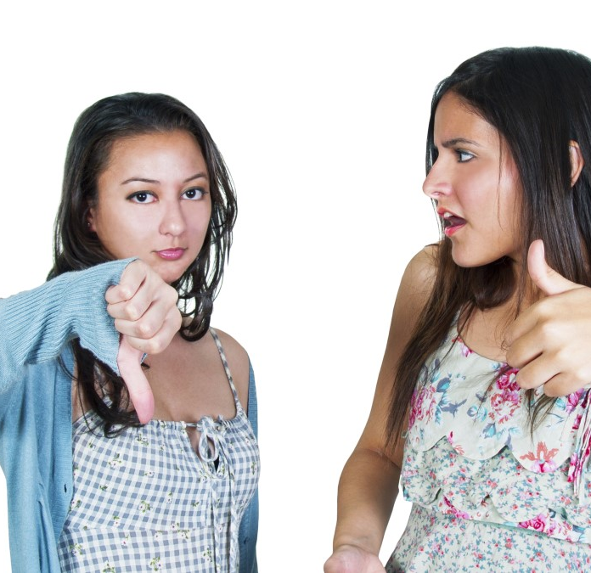
Disagreement Happens
Disagreement is a normal part of life.
How boring would it be if we agreed on everything all the time?
The important thing is to disagree in respectful ways.
Notes:
Explain to students that disagreement is normal! Read the slide. Encourage the students to think about how to disagree with people in respectful ways.

Slide 9
Tips on Disagreeing Respectfully
Notes:
Play the video for the students. 3:22
5 Ways to Respectfully Disagree - How to Disagree politely - YouTube

Slide 10
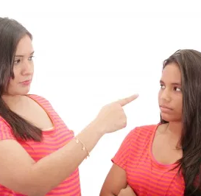
#1 Focus on the issue not the person
Remember that you’re upset, embarrassed, frustrated… at the idea/concept not the person.
Examine your feelings. Did you feel embarrassed, disrespected, frightened. Lead with that feeling.
Notes:
Talk to the students about trying not to make disagreements personal. Encourage students to remember they are mad at the idea/concept the other person is discussing, not the actual person.

Slide 11
#2 Always speak respectfully
Using respectful language and behavior is non-negotiable!
do not:
Yell
Use sarcasm
Make derogatory comments
Be violent
Notes:
Talk about the importance of avoiding put-downs – using respectful language can go a long way. Explain to the students that oftentimes people will SHUT DOWN if they feel disrespected.

Slide 12
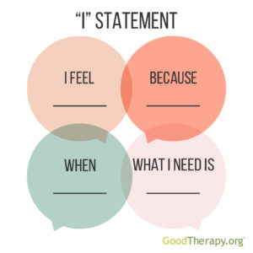
#3 Use "I" Statements
Using "I" Statements is a great way to communicate
How you feel
What you think
What you want/need
Notes:
Read the slide about using I statements. Encourage the students to take note about the anatomy of an I Statement (graphic) and to practice using I Statements to express themselves during disagreements.

Slide 13
#4 Listen to the Other Point of View
Listening shows you respect the other person.
Focus on what is being said.
Verify that you understood them by repeating the key points, Am I understanding you correctly…?
Calmly present your case and why you disagree.
Notes:
Talk about the importance of listening to other peoples points of view. Read the slide for the students. Ask for ideas about how students can SHOW that they are listening to someone: I.e. eye contact, repeating back what the person said, etc.

Slide 14
#5 Stay Calm
The most important thing you can do to keep the conversation on track.
You may need to be the mature one who manages the conversation.
Notes:
Discuss the importance of stayign calm during disagreements. Read the slide to the students and encourage them to discuss ways they can help themselves to calm down if they start to get agitated during a disagreement.

Slide 15
Reflection
Which of the 5 steps listed are the hardest for you?
How can you find ways to work on getting better at disagreeing?
Notes:
Invite the student to engage in reflection utilizing whichever platform you have chosen.

Slide 16
Check Out
Name one thing you're going to do today to help yourself feel good.
Notes:
Engage students in check out by asking them to answer this question in whichever platform you are comfortable with.

Slide 17
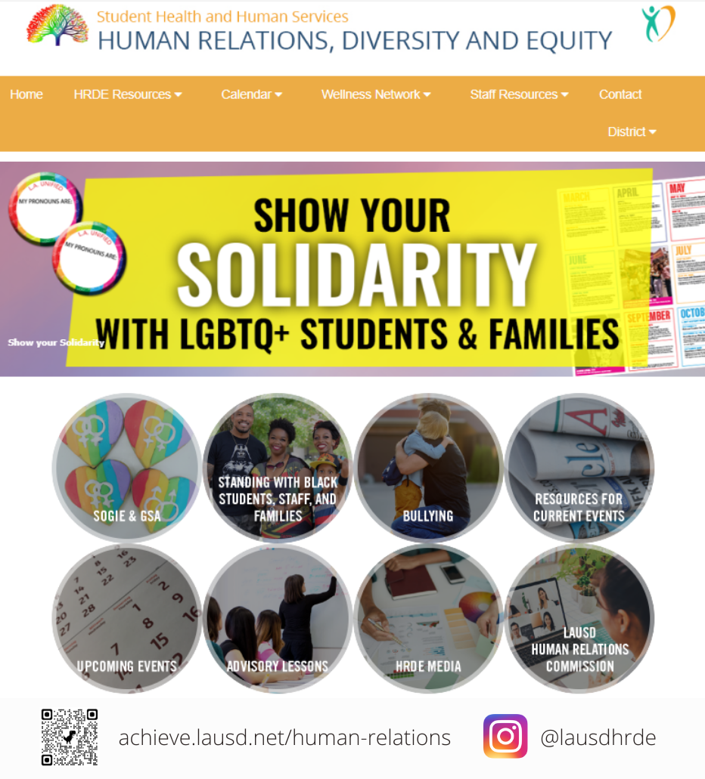
Human Relations, Diversity & Equity

Slide 18
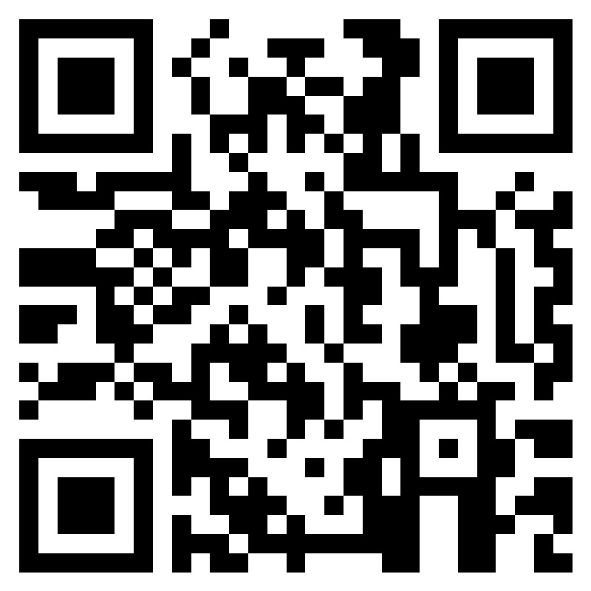
Teacher Feedback Form
Notes:
Teacher, please scan the QR code or click the link to provide feedback.
https://forms.office.com/r/i9UqyyxzTT

